Slide 1

Accelerating active learning with explainability
Sahithya Ravi

Slide 2
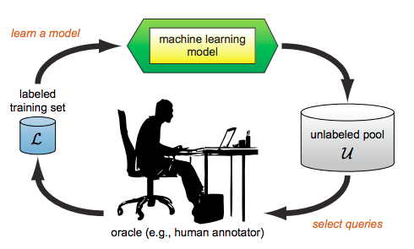
Limitations in AL research
AL – researched to improve labelling efficiency
Interactive ML – but little work focusing on expert
Algorithm centric - simulates an expert
Not much attention to the needs of the annotators eg: transparency, speed

Slide 3
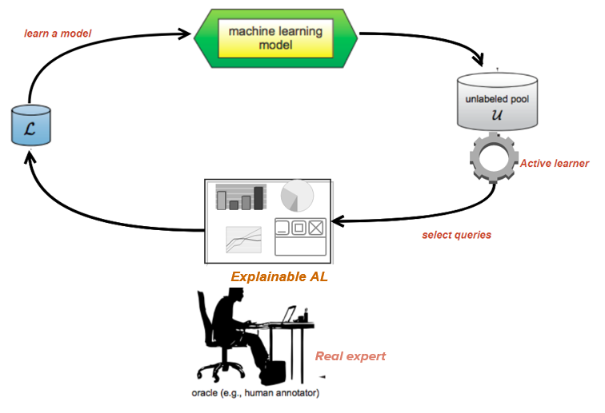
AL framework
Understanding AL strategies: Visualizing active learning strategies – Insight into AL algorithm - data scientists, researchers and in some cases- experts
Speed up annotation process: (guided annotation)
Generating queries that are more transparent and easier to analyze and annotate

Slide 4

Part 1: Active learning exploration
Prototype tool to perform BMAL
Uncertainty maps, cluster visualization and uncertainty changes over different batches
Model results are shown after each batch
Supports 3 BMAL algorithms:
ranked batch mode – top N uncertain examples
k-means uncertain – most uncertain point of the cluster
k-means closest – closest point to the centre

Slide 5
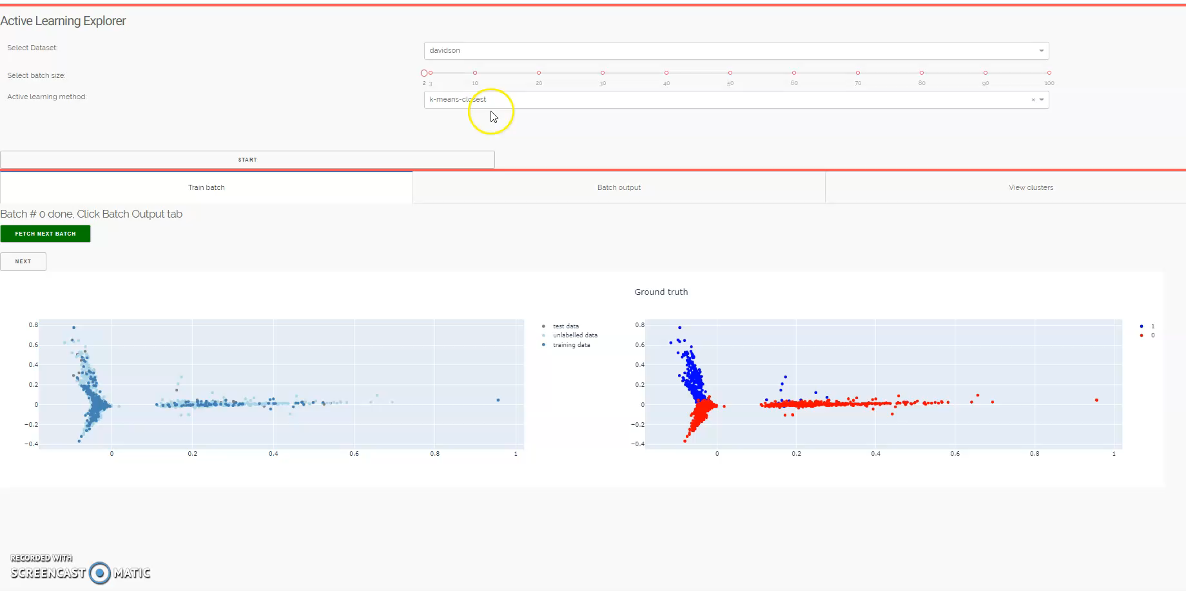
DEMO: Visualizing active learning selection strategies

Slide 6

Part 2: Guiding experts with descriptive clusters
How to explain instances within batches?
Can we improve the speed of annotation futher?
How can we create similar groups which are meaningful and easier to label?
How can we explain the queries within a group?
Can these groups improve the speed of decision-making?

Slide 7
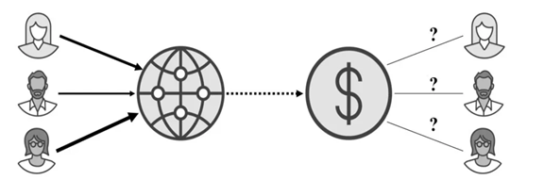
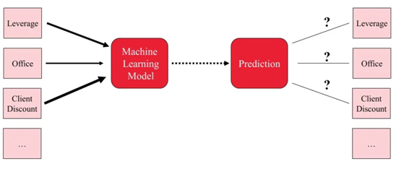
SHAPELY VALUES
Game theory
EXPLAINABILITY
Used in game theory: How to fairly distribute payout among multiple players with different skills?
How to fairly distribute a prediction among different features?

Slide 8
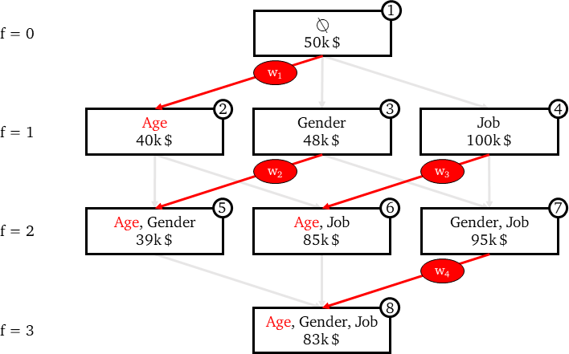
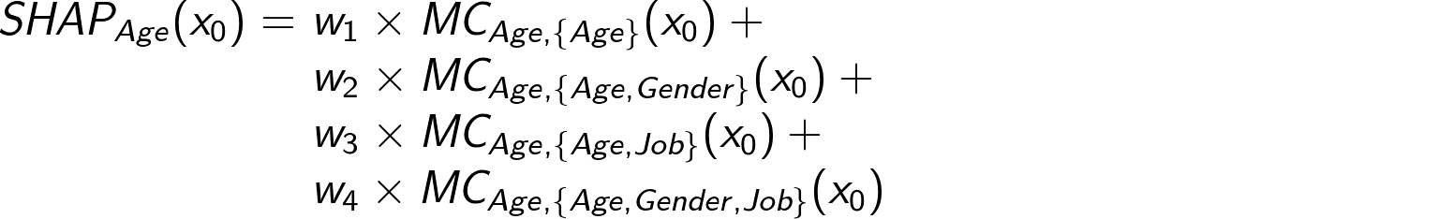
Basic idea of shapely explanations
Find individual contribution from marginal contributions
2^F models
Each edge represents the marginal contribution brought by a feature to a model.

Slide 9
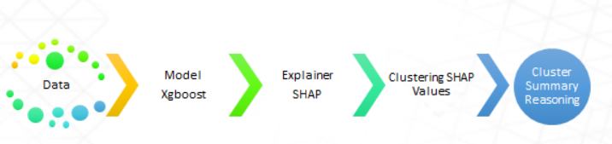
Clustering approach
Clustering is usually performed in feature space
Instead, If we cluster instances by explanation similarity:
improve cluster homogeneity
improve understanding of model by expert
Guide the expert in decision making
STEPS: Generate clusters -> explain the clusters
Pipeline of steps for explainable clustering

Slide 10
Models
We generated SHAP clusters based on different models & datasets:
Dataset | Instances | Type | Models
Davidson hate speech | 5233 | text | SVM, Gradient Boosting classifiers, LSTM
Yelp food reviews | 1000 | text | SVM, Gradient Boosting classifiers, LSTM
Bank customer reviews | 500 | text | SVM, Gradient Boosting classifiers, LSTM
CIFAR | 60000 | image | VGG-16
Covid x-rays, Pneumonia | 951, 8000 | image | VGG-19, Densenet, Resnet

Slide 11
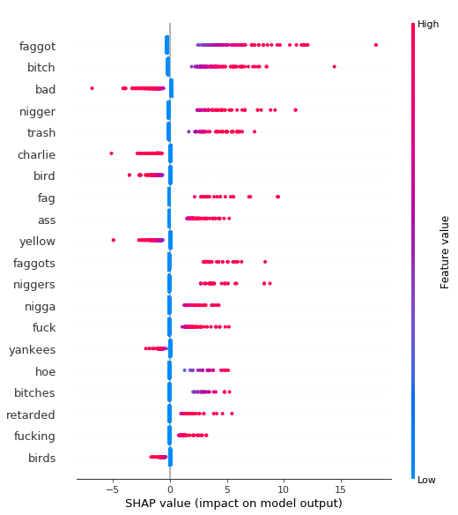
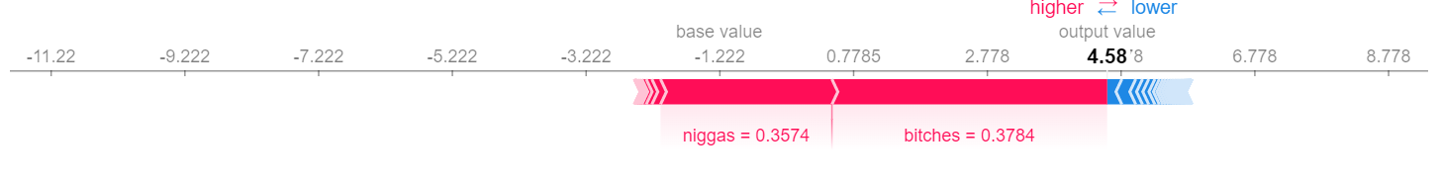
Shapely explanations
Global summary of features for Hate-speech
Explanation of a single instance for hate-speech
niggas wear wigs more than bitches these days
prediction: HATE
True label : HATE
Each point on the summary plot is a Shapley value for a feature and an instance. The color represents the value of the feature from low to high.

Slide 12
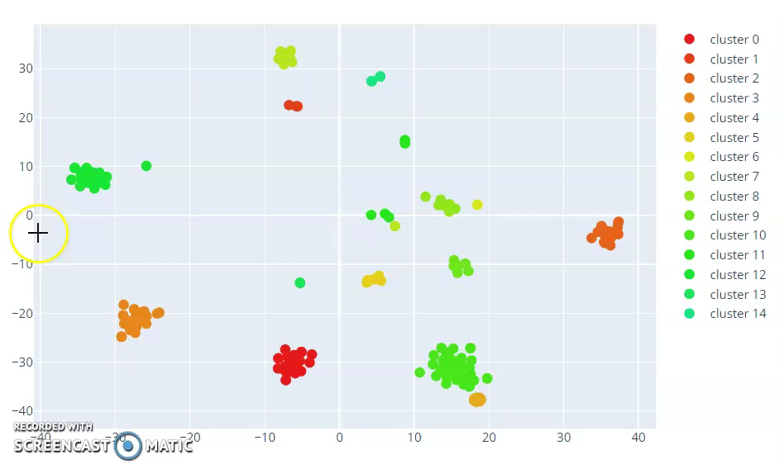
Clustering approach
We cluster instances based on model explanations (shapely values).
Instances within the cluster have common explanations and key contributors to prediction.
For example take a look at these clusters from sentiment analysis

Slide 13
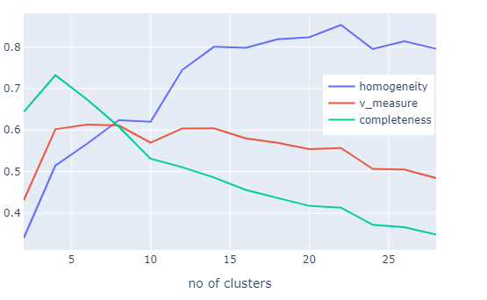
Cluster size and homogeneity
We want to improve homogeneity as long as cluster size is not too large
Number of instances per cluster a domain expert can effectively handle
Fig. shows homogeneity and completeness for clustering 500 instances from hate-speech analysis dataset.
500 – 25 clusters

Slide 14
Prototype guided annotation framework
Train a model based on a small amount of available data (say 50% of the dataset)
Use SHAP explanations cluster unlabeled data pool.
Provide the whole cluster to label.
Highlight top N key features (Common explanations)

Slide 15
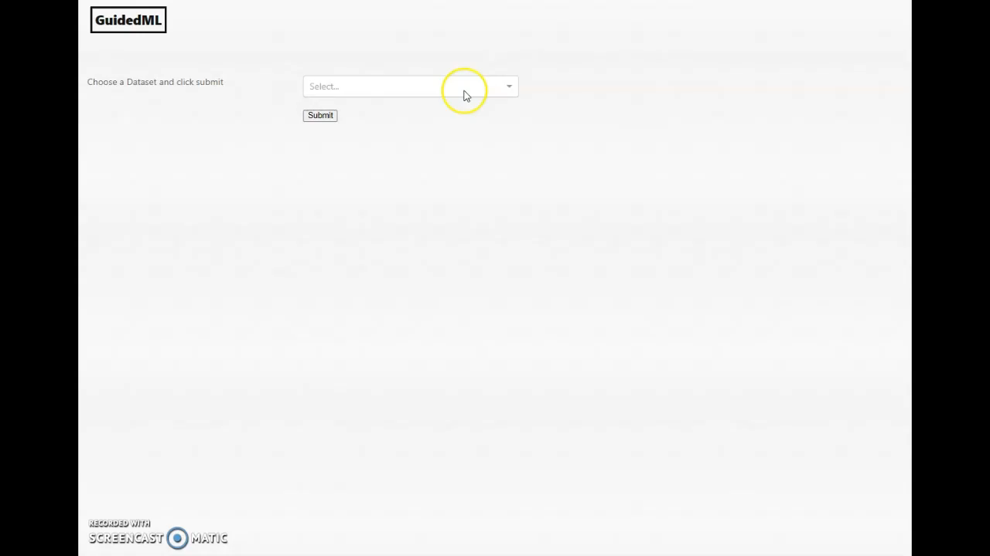
Short demo of faster annotation by guiding the expert

Slide 16
Conclusion & Future work
Initial experiments with guided approach : results in a 3x improvement in annotation speed when compared to individual labelling
Continue experiments with different individuals and datasets, monitor accuracy of labels
Introduce a quantified notion of uncertainty, the idea that an algorithm may be less certain about its decisions on some data clusters than others.
Exploring uncertainity with explainability
How can we estimate uncertainity?
How is the confidence of the model related to clusters based on model explanations?
Can we rank the explainable clusters or batches based on uncertainity?
Can we cluster the most uncertain data points and still achieve explainability?

Slide 17
https://towardsdatascience.com/shap-explained-the-way-i-wish-someone-explained-it-to-me-ab81cc69ef30

